Slide 1
Introduction to the eFlows4HPC software stack and HPC Workflows as a Service methodology
Jorge Ejarque (BSC), Jedrzej Rybicki (JSC), Rosa M Badia (BSC)
EAB Meeting – Barcelona, 22nd of March 2023

Slide 2
Agenda
9:00 – 9:15 | Overview of eFlows4HPC project and tutorial agenda | Rosa M Badia (BSC)
9:15 - 9:35 | Part 1.1: Integrating different computations in PyCOMPSs | Rosa M Badia (BSC)
9:35 – 10:05 | Part 1.2: HPC ready container images | Jorge Ejarque (BSC)
10:05 - 10:35 | Part 1.3: Data Pipelines and Data Logistics Service (DLS) | Jedrzej Rybicki (JSC)
10:35 - 10:55 | Part 1.4: TOSCA Orchestration and HPCWaaS | Jorge Ejarque (BSC)
10:55 – 11:00 | Conclusion of part 1 | Rosa M Badia (BSC)
11:00 - 11:30 | Coffee break
11:30 - 12:05 | Part 2.1: Hands-on session: How to build HPC Ready containers | Jorge Ejarque (BSC)
12:05 - 12:30 | Part 2.2: Hands-on session: How to move data with the DLS | Jedrzej Rybicki (JSC)
12:30 - 12:45 | Part 2.3: Video demonstrating deployment with Allien4Cloud
12:45 - 13:00 | Tutorial conclusions | all presenters

Slide 3
Overview of eflows4HPC

Slide 4
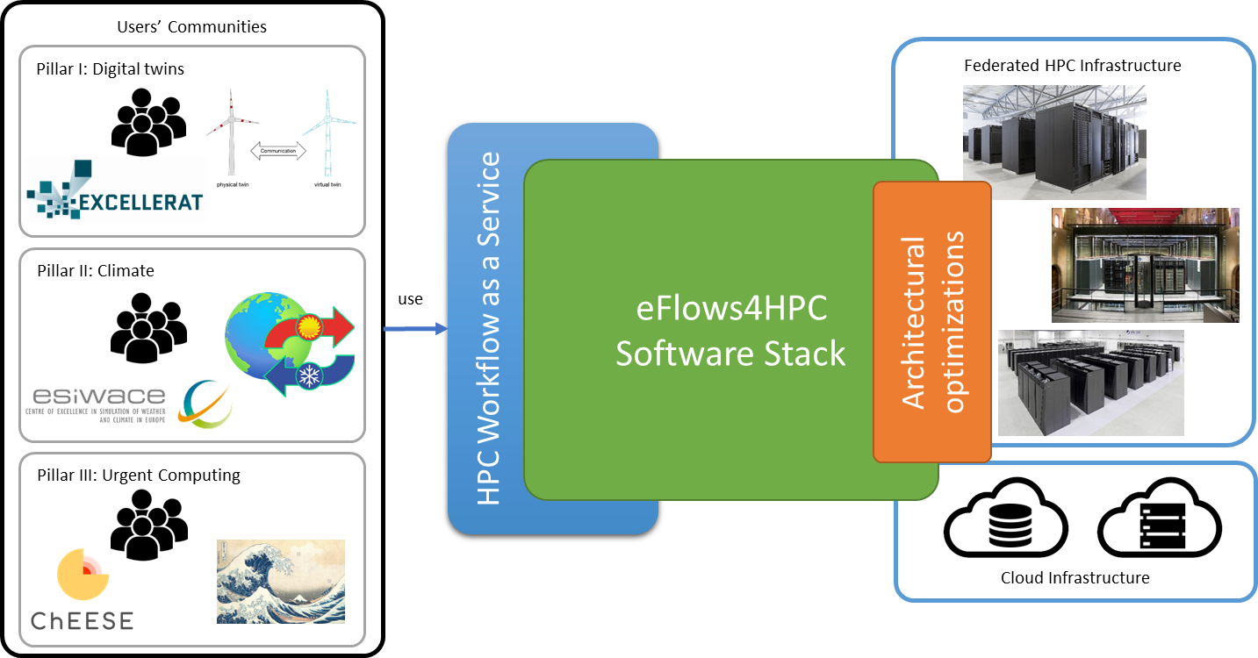
eFlows4HPC in a nutshell
Software tools stack that makes easier the development and management of complex workflows:
Combine different frameworks
HPC, AI, data analytics
Reactive and dynamic workflows
Autonomous workflow steering
Full lifecycle management
Not just execution
Data logistics and Deployment
HPC Workflows as a Service:
Mechanisms to make easier the use and reuse of HPC by wider communities
Architectural Optimizations:
Selected HPC – AI Kernels Optimized for GPUs, FPGA, EPI
Validation Pillar’s
End-user workflows linked to CoEs

Slide 5





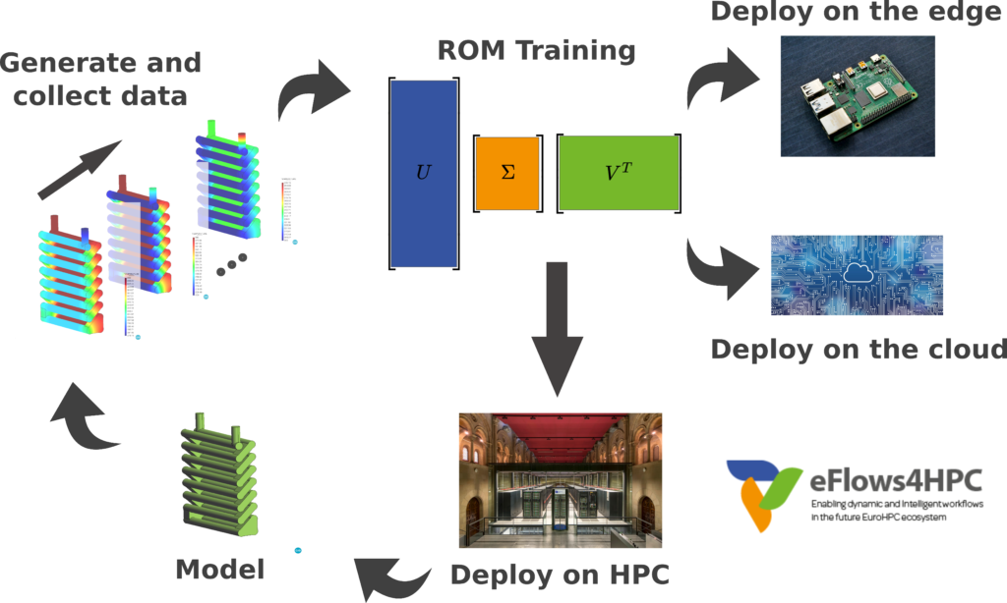
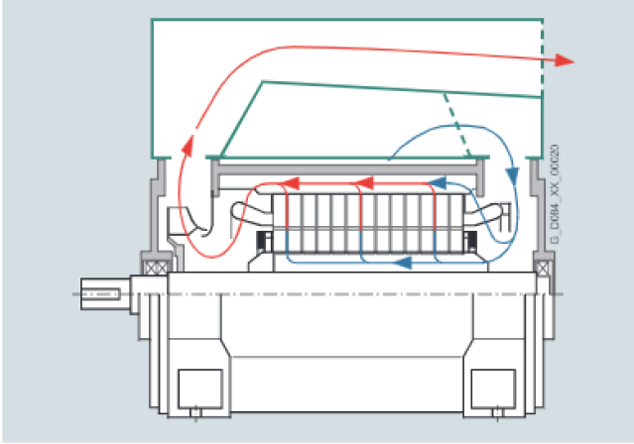

Pillar I: Manufacturing
Pillar I focuses on the construction of DigitalTwins for the prototyping of complex manufactured objects:
Integrating state-of-the-art adaptive solvers with machine learning and data-mining
Contributing to the Industry 4.0 vision
ParMMg
Full order models
validation
Notes:
Simulations with fine element models
SVD
Clustering
Training with neural networks

Slide 6

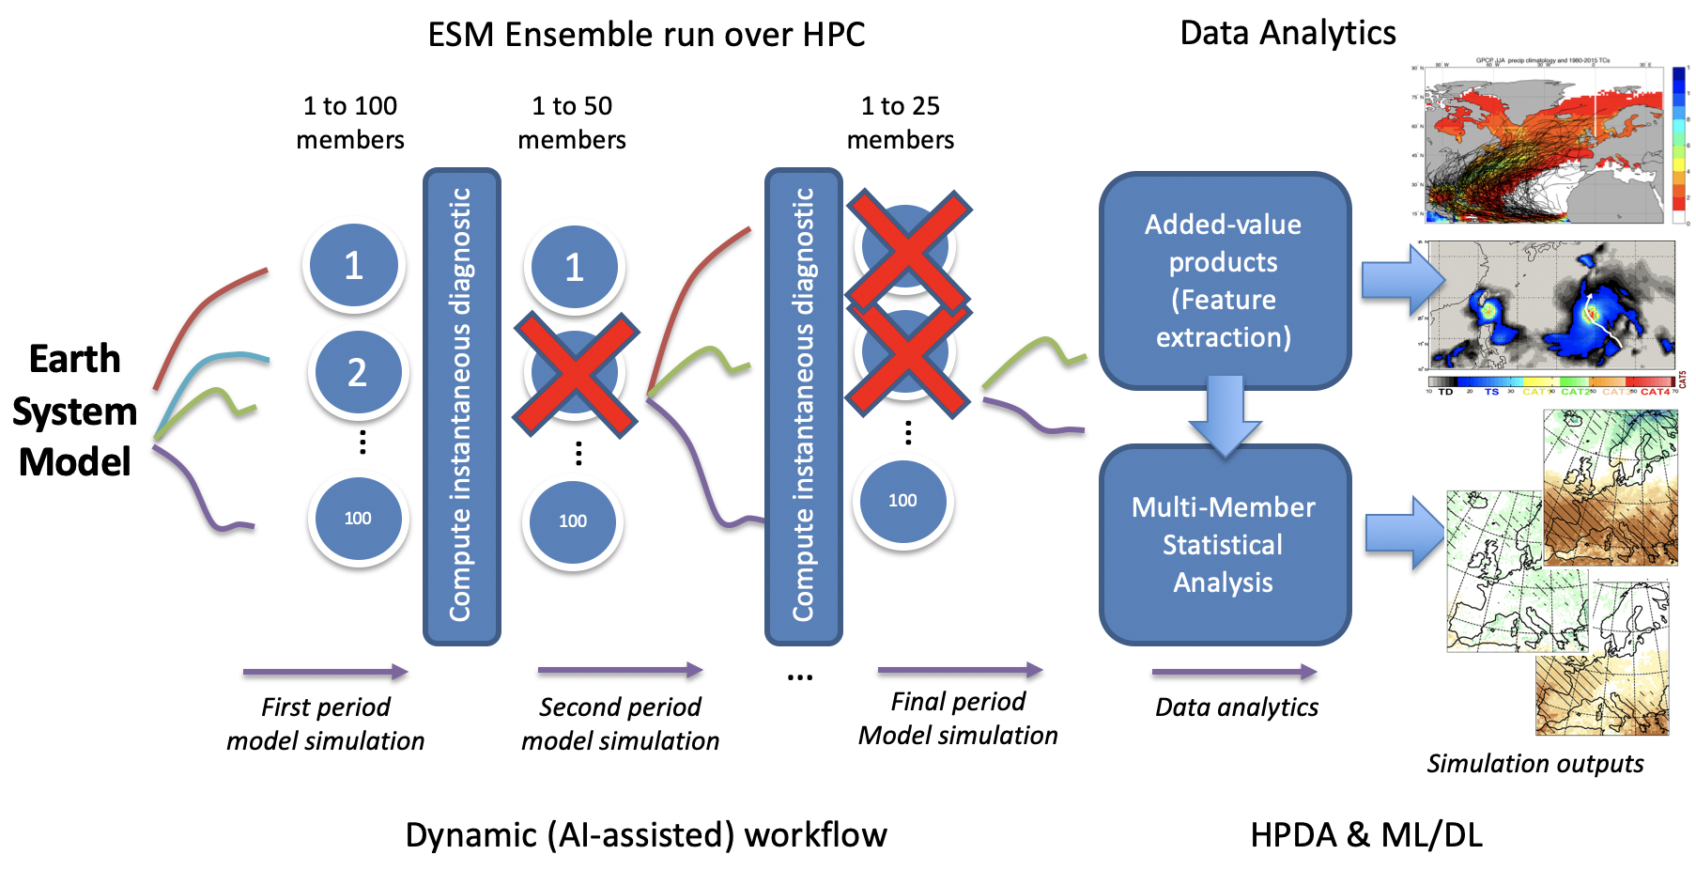
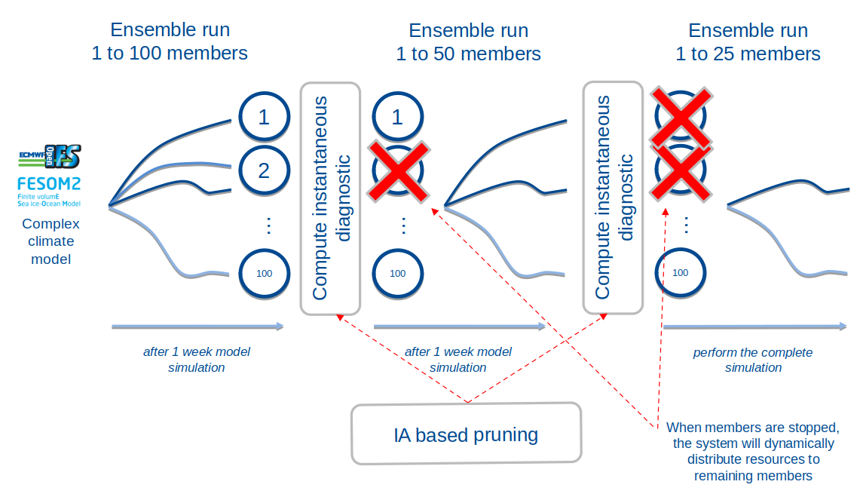


Pillar II: Climate
Perform climate predictions: temperature, precipitation or wind speed
AI-assisted pruning of the ESM workflow
Study of Tropical Cyclones (TC) in the North Pacific, with in-situ analytics
Notes:
Automatic selection of simulated ensemble members to adjust to the HPC capacities available
Tropical cyclones prediction based on ML/DL

Slide 7
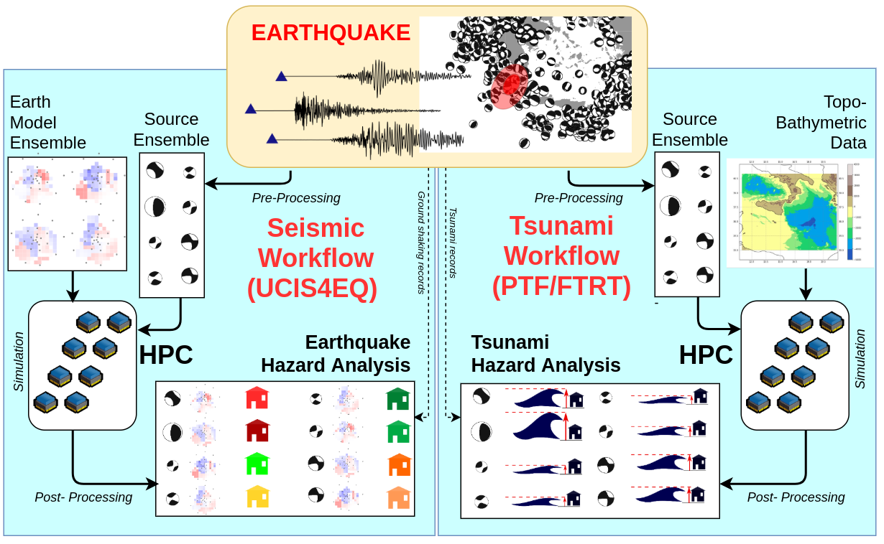
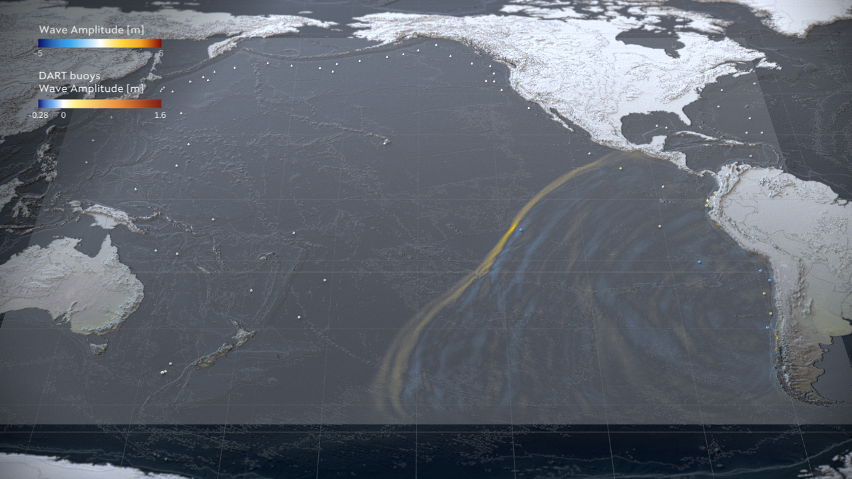





Pillar III: Urgent computing for natural hazards
Pillar III explores the modelling of natural catastrophes:
Earthquakes and their associated tsunamis shortly after such an event is recorded
Use of AI to estimate intensity maps
Use of DA and AI tools to enhance event diagnostics
Areas: Mediterranean basin, Mexico, Iceland and Chile
Tsunami-HySEA GPU-based code
Notes:
Seismic and tsunami urgent computing workflows consist of three main phases (Fig. \ref{fig:WP6_general_phases}):
- A pre-processing phase, in which an ensemble of possible sources is defined based on seismic data assimilation and earthquake parameter estimation, with uncertainty.
- A simulation phase, in which individual scenarios are simulated and ground shaking / tsunami inundation numerically quantified for all the scenarios in the ensemble
A post-processing phase, in which simulation results are processed to produce probabilistic forecasts including both source and modelling uncertainty, eventually updated through newly available observations from the monitoring networks
Probabilistic Tsunami Forecasting (PTF) for tsunami early-warning and urgent computing is based on the generation of an ensemble of Faster Than Real Time (FTRT) tsunami simulations
Tsunami-HySEA GPU-based soft-ware
use of AI for rapid tsunami estimation
use of HPDA and AI tools to enhance event diagnostics and in deeper postprocessing analyse

Slide 8
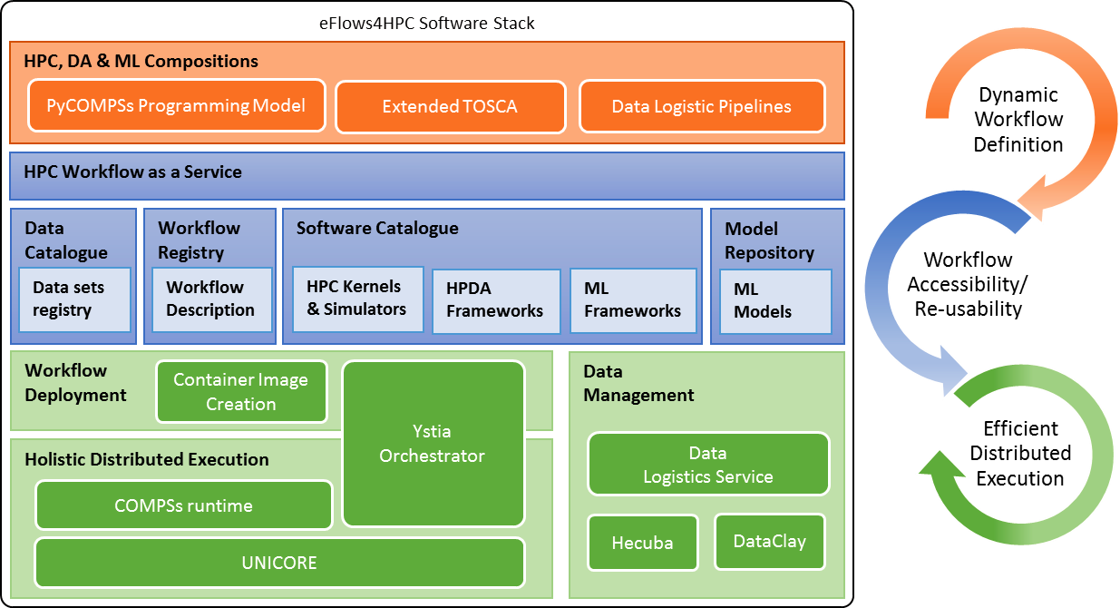

Slide 9



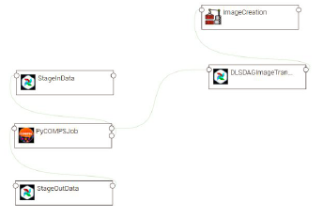
HPCWaaS Overview
Gateway Services
Data Catalogue
Software Catalogue
Workflow Registry
Alien4Cloud
Ystia Orchestrator
Execution API
Input/output datasets
Software Descriptions
5. execute
2. Store
3. Deploy
Dynamic Workflow Description
TOSCA Description
4. share
Data Logistics
Pipelines
PyCOMPSs Code
endpoint to invoke the Workflow
Create Workflow
Description of data movements as python functions.
Computational Workflow as a simple python script.
Topology of the components involved in the workflow lifecycle and their relationship.
Notes:
Just mention set of services to store workflows components data, software used at deployment and thw workflow description is composed by the data pipelines (acquisition of data set, AI modes, images) computational code with PyCOMPSs a task-based programming model which allow to implement distributed workflows as python scripts and TOSCA highlevel orchestrarion of the workflow lifecycle (deployment and execution of worflows and Pipelines)

Slide 10
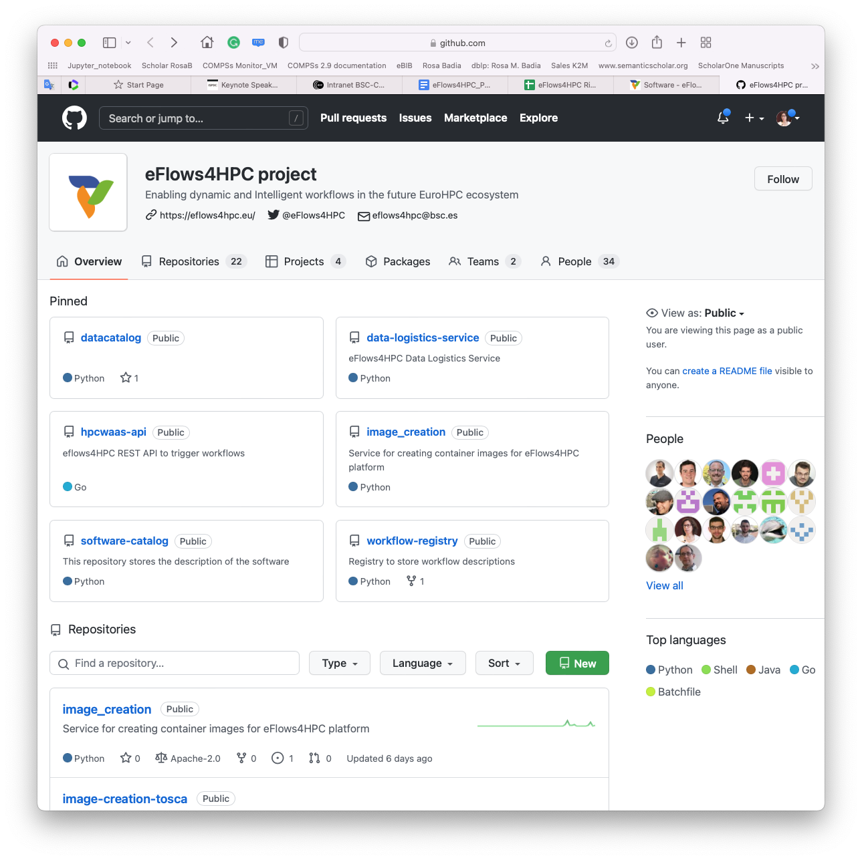
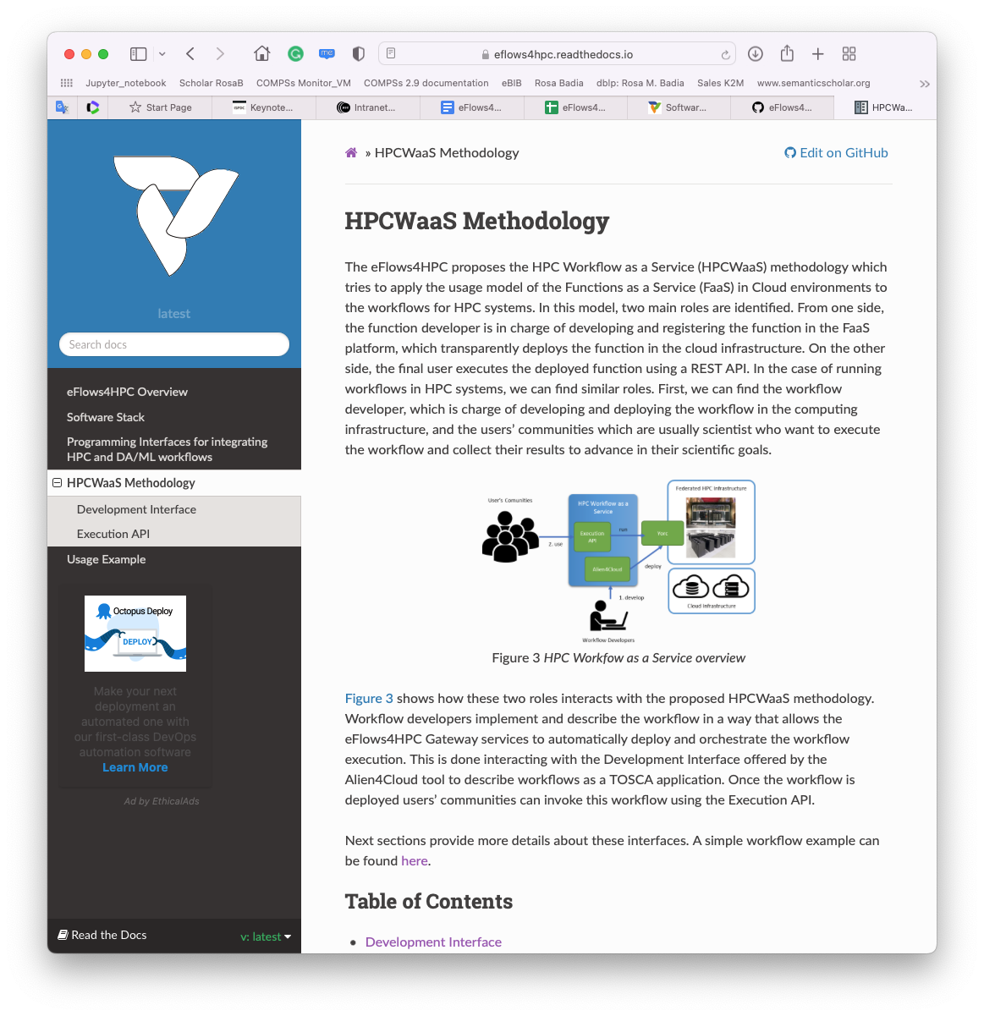
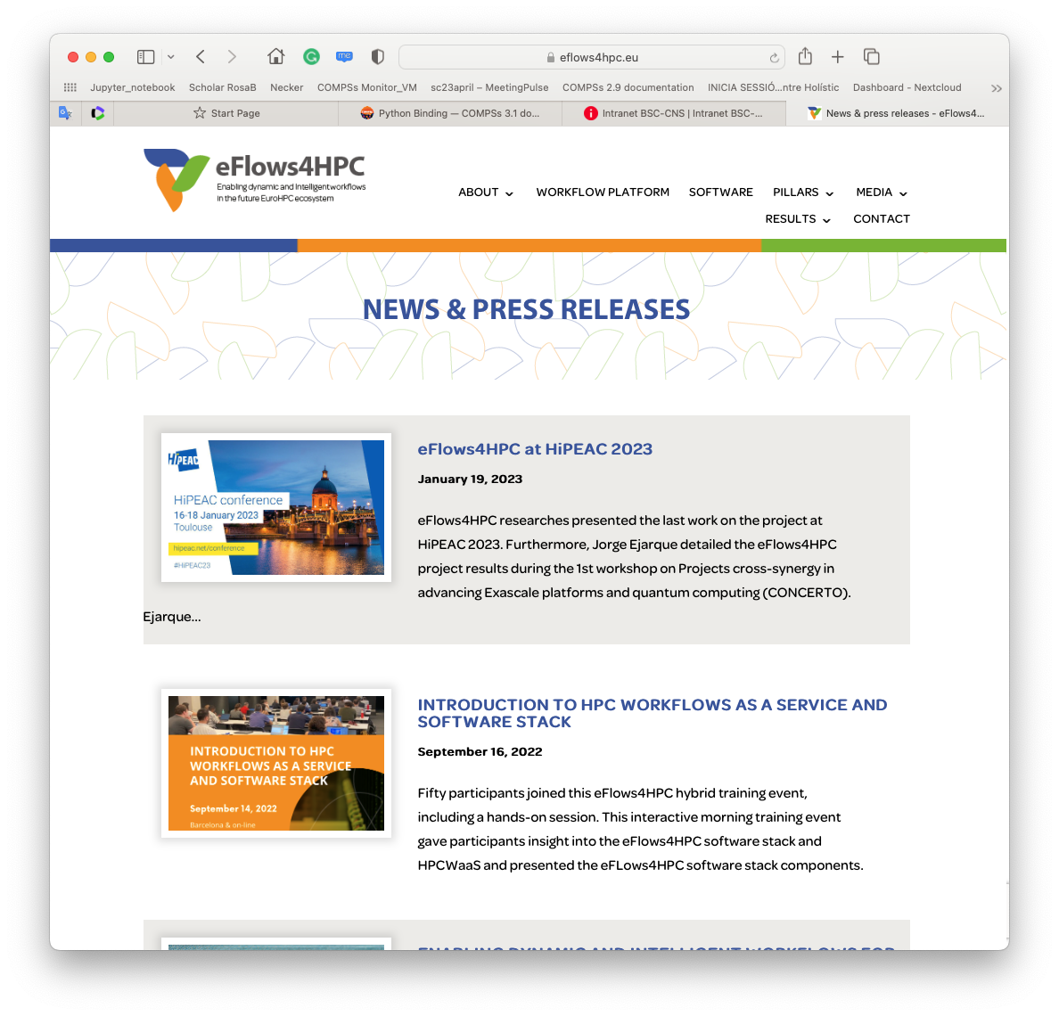
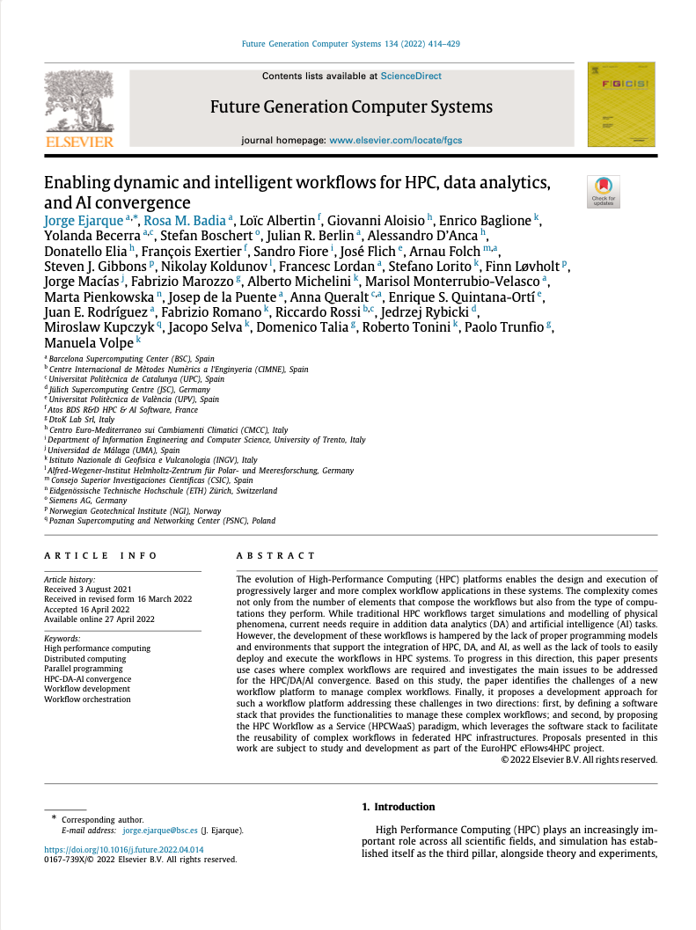
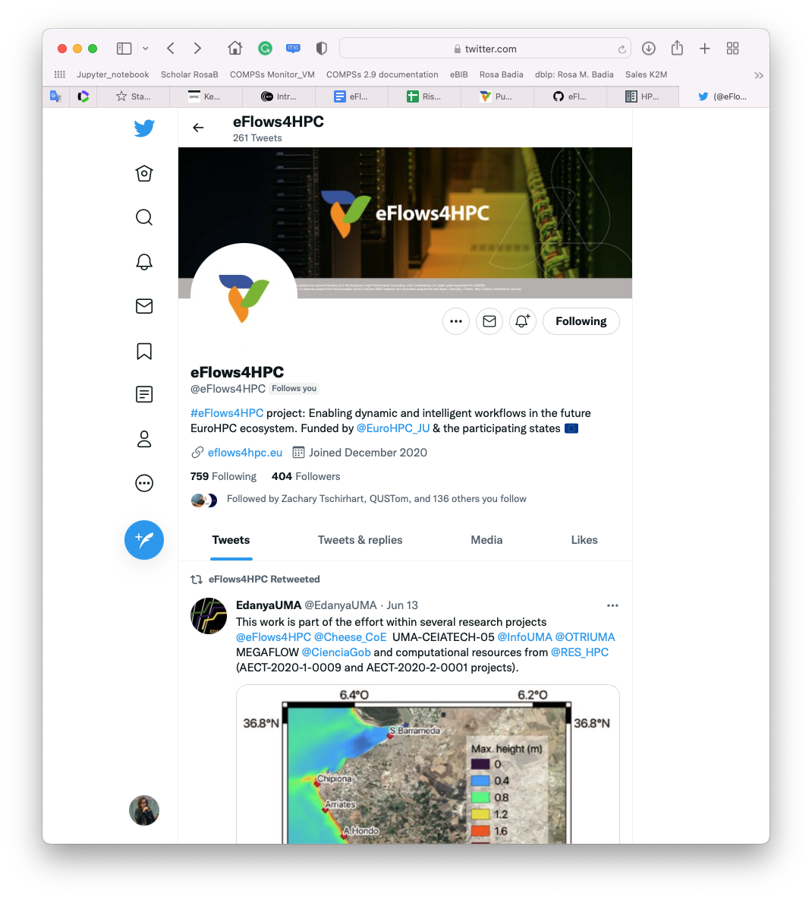
Project achievements
https://eflows4hpc.eu/software/
Requirements and software architecture. Reviewed at beginning of second iteration
Definition and implementation of abstractions to support the integration of different stack components
Design and development of a minimal workflow. Development of a step-by-step example.
Design and implementation of the HPCWaaS API
Design and implementation of project services: Data Catalogue, Workflow Registry, Software catalogue
Design and implementation of first version of Pillars’ workflows.
Two releases of project software and documentation available
Set of internal trainings about software stack components and HPCWaaS. ICS-HPC tutorial
Good visibility: articles, keynote presentations, media

Slide 11
Tutorial focus (I): HPC Workflows as a Service methodology
Part 1.1 How different type of computations (HPC modeling and simulation, artificial intelligence and data analytics) are combined
Part 1.2 How HPC specialized containers are generated
Part 1.3 How the required data transfers are specified and performed
Part 1.4 How the applications are deployed and top level workflow orchestrated

Slide 12
Tutorial focus (II): HPC Workflows as a Service methodology
Part 2.3 How to deploy applications with Alien4Cloud
Part 2.1 How to built HPC Ready containers
Part 2.2 How to move data with DLS

Slide 13

Project partners

